Slide 1



Deploying micro-services app on AWS
Cost optimized deployment with CI/CD model

Slide 2
Contents:
Why CI/CD?
Cost optimization
Deploy on AWS
CI/CD Value

Slide 3


WHY CI/CD?
CI/CD is a powerful engine of software development and it has untold benefits for businesses such as:
CI/CD pipelines Automation reduces the cost !
Deliver faster,
The business bottom line: Expensive developer resources aren’t sitting idle when a successful CI/CD pipeline is in play.
Ensure superior code quality, That concept of “failing fast” means teams aren’t wasting time or resources with buggy code , and devs aren’t plagued with endless “fix” requests when they’ve moved on to other projects. Time is saved, money is saved.
Simplified rollback
The ability to easily rollback code saves teams time, energy, and resources and leads to faster fixes of problem code.

Slide 4
CI/CD Value
Technical Language | Value | Translation
Catch Compile Errors After Merge | Reduce Cost | Less developer time on issues from new developer code
Catch Unit Test Failures | Avoid Cost | Less bugs in production and less time in testing
Detect Security Vulnerabilities | Avoid Cost | Prevent embarrassing or costly security holes
Automate Infrastructure Creation | Avoid Cost | Less human error, Faster deployments
Automate Infrastructure Cleanup | Reduce Cost | Less infrastructure costs from unused resources
Faster and More Frequent Production Deployments | Increase Revenue | New value-generating features released more quickly
Deploy to Production Without Manual Checks | Increase Revenue | Less time to market
Automated Smoke Tests | Protect Revenue | Reduced downtime from a deploy-related crash or major bug
Automated Rollback Triggered by Job Failure | Protect Revenue | Quick undo to return production to working state

Slide 5
Deploy on AWS
Amazon Web Services (AWS) delivers reliable, scalable, and cost-effective computing resources on which to host your applications.
Businesses can consume applications that are hosted online,
enabling them to lower their costs by paying only for what they use,
enjoy seamless and painless upgrades in functionality,
and integrate easily with their existing data and systems.

Slide 6
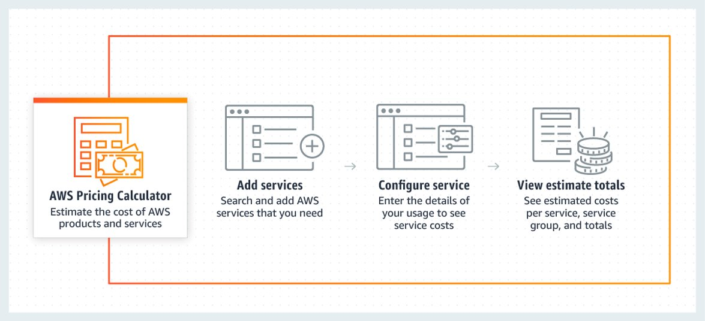
Cost optimization
Deploying applications on AWS cloud using CICD tools is superior in Time and Cost saving
AWS provides a free pricing calculator that allows you to start your estimate with no commitment and explore AWS services and pricing for your architecture needs.
Also, AWS services provide many financial management solutions. you can,
Organize and Report Cost and Usage based on User-Defined Methods
Manage Billing and Control Costs
Optimize Costs with Resource and Pricing Recommendations
Improved Planning with Flexible Forecasting and Budgeting

Slide 7
Thanks !
Hope it was helpful and convenient

